Slide 1
UMD DATA605 - Big Data Systems ETL
GP Saggese
gsaggese@umd.edu
with thanks to
Alan Sussman
Amol Deshpande

Slide 2
UMD DATA605 - Big Data Systems Git

Slide 3

Git - Resources
Concepts in the slides
Tutorial here
Mastery: Pro Git (free)
Web resources:
dangitgit.com (aka Oh Sh*t, Git!?!)

Slide 4
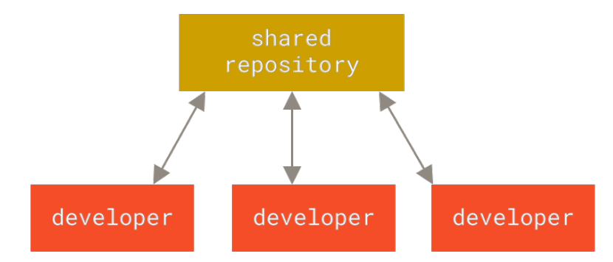
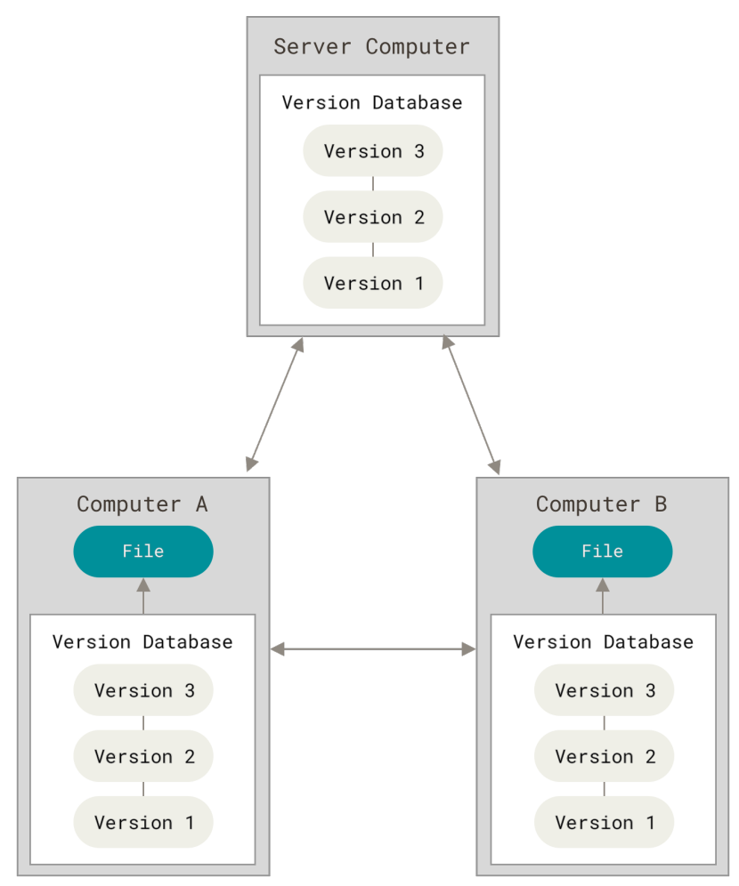
Version Control Systems
A VCS is a system that allows to:
Record changes to files
Recall specific versions later
Track who changed what
Compare changes over time
Simplest version control
Make a copy of a dir and add a timestamp (or worse `_v1`)
Centralized VCS
E.g., Perforce, Subversion
There is a server storing the code, a clients that connect to it
If the server is down, nobody can work
Distributed VCS
E.g., Git, Mercurial, Bazaar
Clients have the entire history of the repo locally
Each client is a repo server

Slide 5
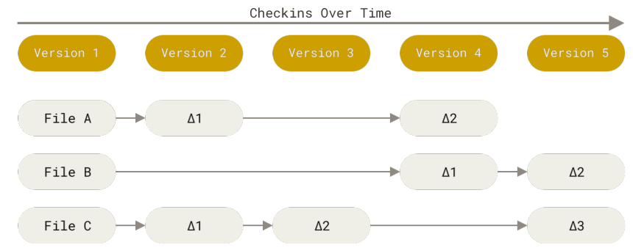
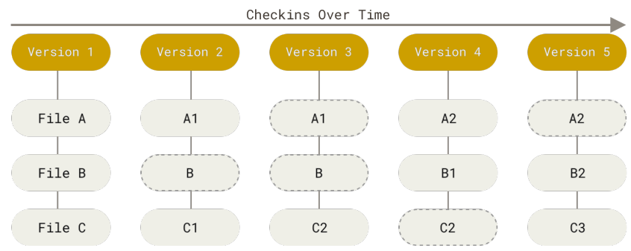
VCS: How to track data
Delta-based VCS
E.g., Subversion
Store the data in terms of patches (changes of files over time)
Stream of snapshots
E.g., git
Data in terms of snapshots of a filesystem
Take a picture of what your files look like
Store reference to the snapshots
Save link to previous identical files
Git is like a mini file-system / key-value store with a VCS built on top

Slide 6
Git
Almost everything is local for Git
History is stored locally
Diff-ing is done locally
You can commit to your local copy
Upload changes when there is network connection
Almost everything is undoable in Git
No data corruption
Everything is checksummed
Almost nothing can be lost (ideally, besides git-hell)
You need to know how to do it
Git is like a key-value DB

Slide 7
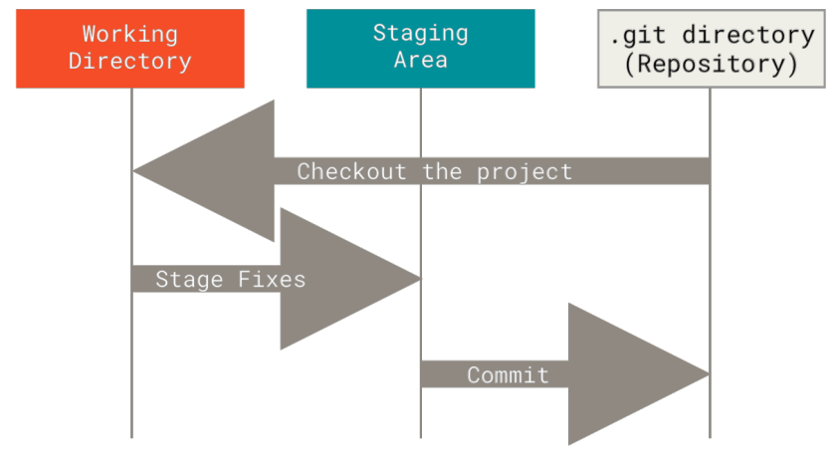
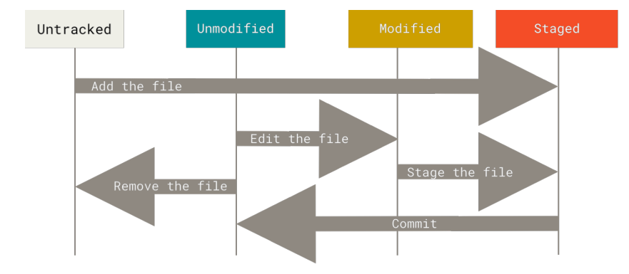
States of a file in Git
There are 3 main sections of a Git project:
Working tree (aka checkout)
Version of the code that is placed on the file for the user to use and modify
Staging area (aka cache, index)
A file in `.git` that stores information about the next commit
Git directory (aka `.git`)
Store metadata and objects DB
It is the repo itself with all history
When you clone, you get the `.git` of the project
Each file can be in 4 states
Untracked: files that are not under version control (i.e., not under the previous snapshot)
Modified: you have changed the file, but not committed to DB yet
Staged: you have marked a modified file in its current version to go into your next commit snapshot
Committed: data is safely stored in your local DB
Every-day work workflow
Modify files in working tree (vi ...)
Stage changes for the next commit (git add -u, ...)
Commit changes to `.git` (git commit)

Slide 8
3 states of a Git file
Each file can be in 3 states
Untracked: files that are not under version control (i.e., not under the
previous snapshot)
Modified: you have changed the file, but not committed to DB yet
Staged: you have marked a modified file in its current version to go into your next commit snapshot
Committed: data is safely stored in your local DB

Slide 9
Git daily use
move across
git stash

Slide 10
Git remote
Remote repos are versions of your project hosted on Internet or on a “remote” file
To collaborate you need to manage remote repos
Push / pull changes
You can have multiple repos with different policies read-only read-write
`git fetch`: pull all the data from the remote project that you don’t have (e.g., branches, commits)
`git pull` is a short hand from `git fetch origin` + `git merge --rebase`
`git push <REMOTE> <BRANCH>`
E.g., `git push origin master`
If somebody pushed to the remote, you can’t push right away, but you need to:
Fetch the changes
Merge them in your client
Resolve conflicts (optional)
Push it to the remote

Slide 11
Git tagging
Git allows to mark specific points in history with a tag (e.g., release points)
You can check out a tag
You get in detached HEAD state
If you commit your change won’t be added to the tag or to the branch
The commit will be unreachable (only by the commit hash)

Slide 12
Git internals
Git is a key-value store with a VCS user interface on top of it
Key = hash of a file
Value = content of a file
You can understand Git only if you understand the data model
Git objects
Blobs
Trees
Commits
Tags

Slide 13
Git branching
Branching = diverging from the main line of development
Why?
Work without messing the main line of development
Work without being affected by changes in main branch
Once you are done with working in the branch, merge code
Git branching is lightweight
It’s instantaneous
A branch is just a pointer to a commit
Git doesn’t store data as difference of files, but as a series of snapshot
Git branching workflows branch and merge often (even multiple times a day)

Slide 14
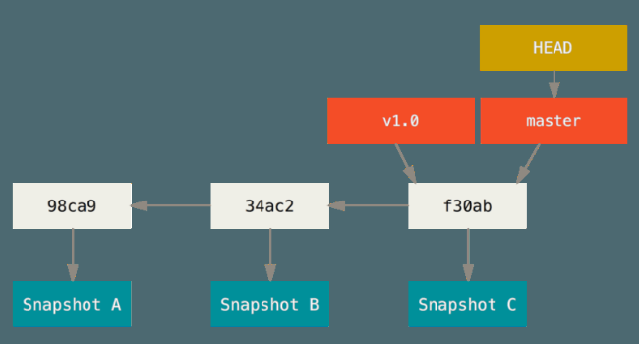
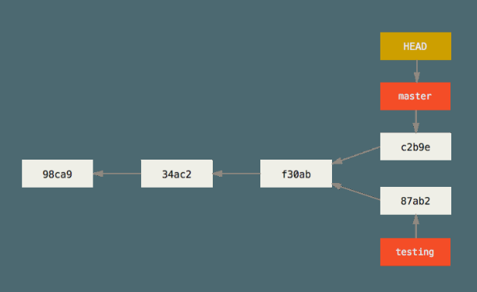
Git branching
`master` (or `main`) is just a normal branch
`master` is a pointer to the last commit
As you commit the pointer moves forward
`HEAD`
pointer to the local branch you are on
`git branch testing`
creates a new pointer `testing`
points to the commit you are on
can be moved around
Divergent history
When work progresses in two branches

Slide 15
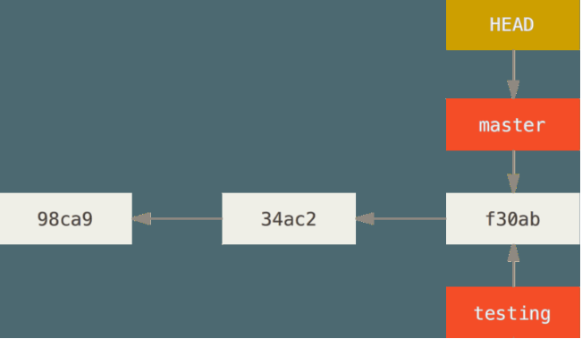
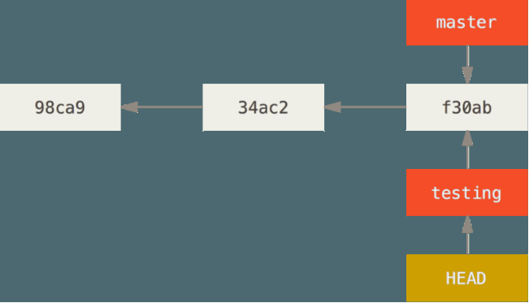
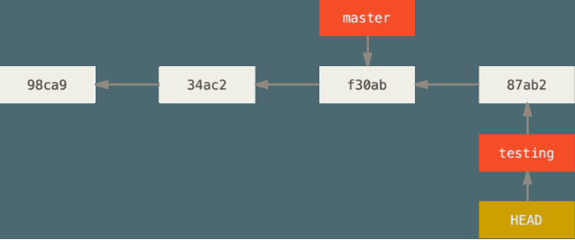
Git branching
To switch branch `git checkout`
moves `HEAD` to the new branch
changes the files in the working dir to match the state corresponding to the branch pointer

Slide 16
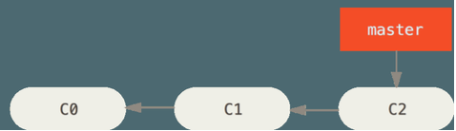
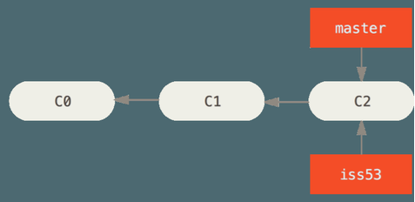
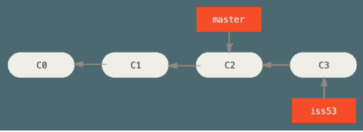
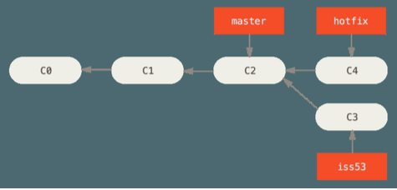
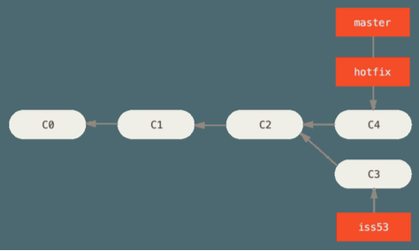
Basic branching and merging
# Start from a project with some commits
# Branch to work a new feature
> git checkout -b iss53
work ... work ... work
> git commit
# Need a hot fix to master
> git checkout master
> git checkout -b hotfix
fix ... fix ... fix
> git commit -am “Hot fix”
> git checkout master
> git merge hotfix
Fast forward
Note that there is a divergent history now

Slide 17
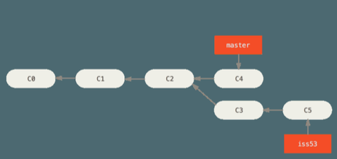
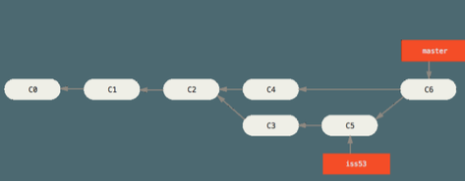
> git checkout iss53
Keep diverging
You are done with iss53 and you want to merge your work back to master
Go to the target branch
> git checkout master
> git merge iss53
Git can’t fast forward
Git creates a new snapshot with the 3-way merge, creates a new “merge commit” (commit with more than one parent)
> git branch -d iss53

Slide 18

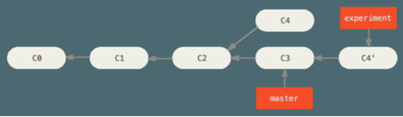
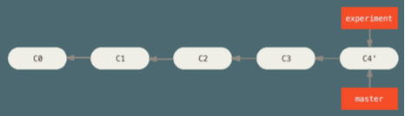
Fast forward merge
Merge a commit X with a commit Y that can be reached by following the history of commit X
There is not divergent history to merge
Git simply moves the branch pointer forward from X to Y

Slide 19
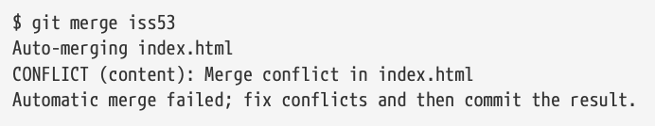
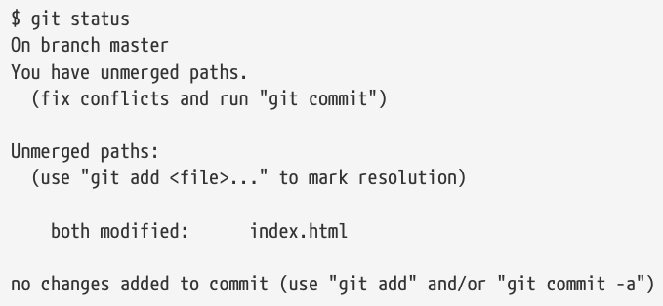
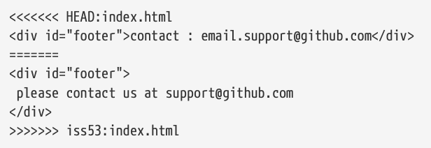
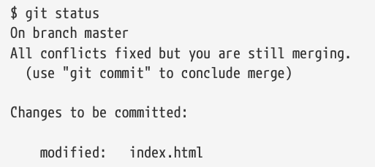
Merging conflicts
If Git can’t merge (e.g., the same file has been modified by both branches, one file was modified by one branch and deleted by another)
Git does not create a merge commit but pauses to let you resolve the conflict
Git adds conflict resolution markers
Merge
Edit the files and `git add`
`git mergetool`
Use PyCharm
git commit

Slide 20
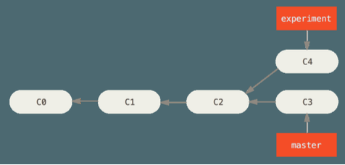
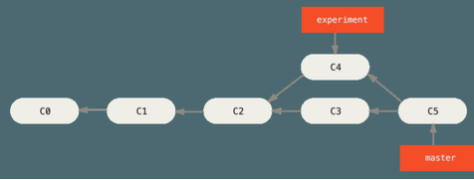
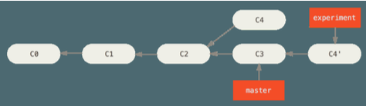
Git rebasing
In Git there are two ways of merging divergent history
master and experiment
Have a common ancestor C2
Merge
Create a new snapshot C5 and commit
# Go to the target branch.
git checkout master
git merge experiment
Rebase
# Go to the branch to rebase.
git checkout experiment
git rebase master
# Equivalent to
git rebase master experiment
In other words it is like:
Get all the changes committed in the branch where we are (C4) since the common ancestor (C2)
Sync to branch that we are rebasing onto (master at C3)
Apply the changes `C4'`
Only the branch where we are is affected

Slide 21
Uses of rebase
Rebasing makes for a cleaner history
The history looks like all the work happened in series
Although in reality it happened in parallel to the development in `master`
Rebasing to contribute to a project
You are contributing to a project that you don't maintain
You work on your branch
When you are ready to integrate your work, rebase your work onto `origin/master`
The maintainer does not have to do any integration work: just a fast forward or a clean apply

Slide 22
Golden rule of rebasing
Strict version: "Do not rebase commits that exist outside your repository"
Loose version: “It’s ok to rebase your branch even if you pushed to a server, as long as you are the only one to use it”
The problem is:
1. You push your commits somewhere
2. Others pull your commits down and base their work on them
3. You rewrite those commits with `git rebase` and push them again with
`git push --force`
4. Your collaborators have to re-merge their work
Rebasing means abandoning existing commits and creating new ones that are similar but different

Slide 23
Rebase vs Merge
Rebase and merge are related to what interpretation we give of the repository commit history
What does the history of a repo mean?
a) A record of what actually happened
b) A story of how your project should have been made
a) Commit history is a record of what actually happened
History should not be tampered with
What if there is a series of messy merge commits?
This is how it happened
The repo should preserve this
Use `git merge`
b) Commit history is the story of how a project should have been made
You would not publish a book as a sequence of drafts and correction, but
rather the final version
Tell the history in the way that is best for future readers
Use `git rebase` and filter-branch
Best of the merge-vs-rebase approaches
Rebase changes you've made in your local repo but haven't pushed yet
Clean up your history
Merge to master to preserve the history of how something was built

Slide 24
Remote branches
Remote branches are pointers to branches in remote repos
E.g., `github.com:alphamatic/surrentum`
`git remote ...`
Tracking branches
Local reference representing the state of the remote repo
E.g., `master` tracks `origin/master`
Can’t change the remote branch (e.g., `origin/master`)
Can change tracking branch (e.g., `master`)
Git updates them when you do `git fetch origin` (or `git pull`)
To share code in a local branch you need to push them to a remote
git push origin serverfix
To work on it
git checkout -b serverfix origin/serverfix

Slide 25
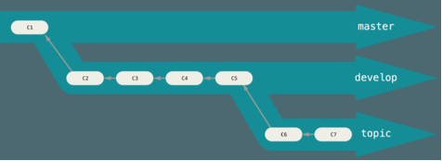
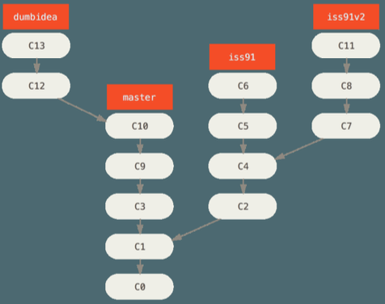
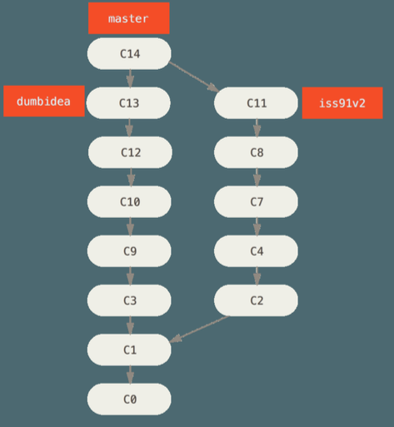
Git workflows
Workflows
= ways of working and collaborating using Git
Long-running branches
Branches at different level of stabilities, that are always open
1. `master` is always ready to be released
2. `develop` to develop in
3. Topic / feature branches
When they are "stable enough" they are integrated up
You can merge them regularly into others (e.g., `master`)
Topic branches
Short-lived branches that you create and use for a single feature
E.g., `hotfix`, `wip-XYZ`
Easy to review
Silo-ed from the rest
This is typical of Git since other VCS support for branches is not good enough

Slide 26
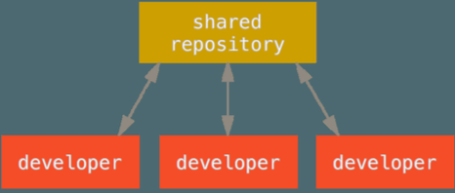
Centralized workflow
Typical model for centralized VCS
Developers:
Check out the code from the central repo on their computer
Modify the code locally
Push it back to the central hub (assuming no conflicts with latest copy, otherwise they need to merge)
Centralized workflow in Git
Any number of developers can use this workflow
Every dev:
has push (i.e., write) access to the central repo
Cannot push code that will overwrite each other code (only fast-forward changes)
Needs to fetch and then merge

Slide 27
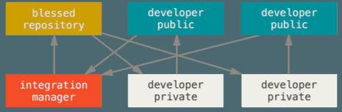
Integration-manager Workflow
This is the classical model for open-source
E.g., Linux, GitHub fork
Each dev has:
Write access to their own public repo
Read access to everyone else's public repo
1. One repo is the "official" project
Only the project maintainer pushes to the public repo
2. Each contributor:
Clones ("forks") the project into a private copy
Makes changes
Pushes changes to his own public copy
Sends email to maintainer asking to pull changes (pull request)
3. The maintainer:
Adds contributor repo as a remote
Merges the changes into a local branch
Tests changes locally
Pushes branch to official repo

Slide 28
Git forks
Forked public project workflow
Typically devs don't have permissions to update directly branches on the project
The approach is based on forking
Clone the repo and create a branch with your work
Create a writable fork of the project
Push your branch there
Prepare a PR / a patch
Project maintainer accepts and integrates PRs / patches

Slide 29
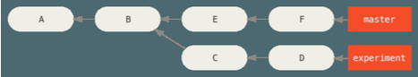
Git log
References
HEAD
origin/master
experiment
d921970
^ after a reference resolves to the parent of that commit
HEAD^ = commit before HEAD, i.e., last commit
A merge commit has multiple parents
^2 means ^
Double-dot notation
1..2 range of commits that are reachable from 2 but not from 1
git log master..experiment -> D,C
git log experiment..master -> F,E
Triple-dot notation
1...2
commits that are reachable from either of the two differences but not from both
git log master...experiment -> F,E,D,C

Slide 30
Git: advanced
stashing
Copy state of your working dir (e.g., modified and staged files), save it in a stack, to apply later
cherry-picking
Rebase for a single commit
rerere
Reuse Recorded Resolution
Git caches how to solve certain conflicts
tagging
Give a name to a specific commit (e.g., v1.3)
submodules / subtrees
Project including other Git projects
bisect
Sometimes a bug shows up at top of tree but you don't know at which revision it started manifesting
You have a script that return 0 if the project is good and non-0 if the project is bad
Bisect can find the revision at which the script goes from good to bad
filter-branch
Rewrite history in some script-able way
E.g., change your email, remove a file (with passwords or large file)
Check out each version, runs the command, commit the result
hooks
Run scripts before each commit, merging, ...

Slide 31
GitHub
GitHub: largest host for Git repos
Git hosting (many open source projects)
PRs, forks
Issue tracking
Code review
Collaboration
In open-source communities, “forking a project” had a negative connotation
Take a project, modify it, and make it a competing project
In GitHub parlance, forking means making a copy to a project so that you can contribute it even if you don’t have push / write access

Slide 32
UMD DATA605 - Big Data Systems Data pipelines DevOps with Docker Airflow
Unit-testing
REST API

Slide 33
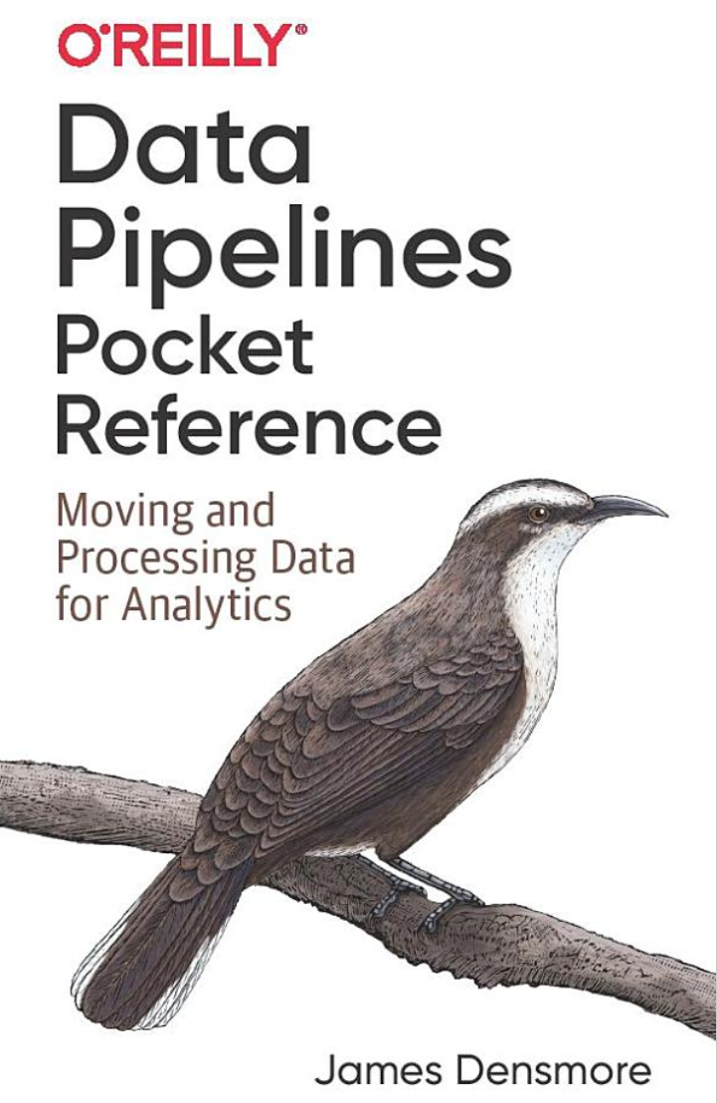
Data pipelines - Resources
Concepts in the slides
Mastery: Data Pipelines Pocket Reference: Moving and Processing Data for Analytics

Slide 34
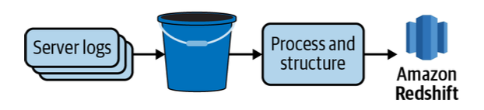
Data pipelines
Data is the new oil, but it needs to be:
collected
preprocessed / cleaned
validated
processed
combined
Data pipelines
Set of processes that move and transform data so that new value can be derived (through analytics, reporting, machine learning)
Simplest data pipeline
Extract data from REST API
Load into SQL table

Slide 35
Roles in Building Data Pipelines
Data engineers
Build and maintain data pipelines
Tools:
Python / Java / Go / No-code
SQL / NoSQL stores
Hadoop / MapReduce / Spark
Cloud computing
Data scientists
Build predictive models
Tools: Python / R / Julia
Data analysts / Marketing
Build metrics and dashboards
Tools: Tableaux, spreadsheets
Problems in practice
Who is responsible for the data?
Talk to stakeholders on a regular basis
Scaling
Architecture
Service level agreement
Done is better than perfect

Slide 36
Data ingestion
= extract data from one source and load it into another
Data sources
DB
REST API (abstraction on top of DBs)
Network file system / Cloud (e.g., logs, CSV files, Parquet files)
Data warehouses
Data lakes
Source ownership
An organization can use 10-100s of data sources
Internal (e.g., Postgres DB storing shopping carts)
3rd-parties (e.g., Google analytics tracking website usage)

Slide 37
Structured data
Structured data from SQL, DB
Semi-structured (e.g., logs, HTML pages)
Unstructured (e.g., text, nested JSON)

Slide 38
Cleaning
Data cleanliness
Quality of source data varies greatly
Typically messy
Duplicated records
Incomplete or missing records
Inconsistent formats (e.g., phone with / without dashes)
Mislabel or unlabeled data
When to clean it?
As soon as possible
ETL (Extract-Transform-Load) vs ELT
Mantras
Hope for the best, assume the worst
Validate data early and often

Slide 39
Data volumes
Spectrum: high-volume vs low-volume
One-shot vs streaming
High-velocity vs low-velocity
Other challenges
API rate limits / throttling
Connection time-outs
Slow downloads

Slide 40
Data lake: pros and cons
Pros:
Storing data in cloud storage is cheaper
Making changes to types or properties is easier since it's unstructured or semi-structured (with no predefined schema)
E.g., JSON documents
Data scientists
don't know initially which data to use and how to access the data
want to explore the raw data
Cons:
It is not optimized for querying like a structured data warehouse
There are tools that allow to query data in a data lake similar to SQL
E.g., AWS Athena, Redshift Spectrum

Slide 41
Data warehouse vs Data lake
Data warehouse
DB storing data from different systems in a structured way to optimize queries
E.g., a large Postgres instance with many DBs and tables
Data lake
Data stored in a semi-structured or without structure
E.g., an S3 bucket storing blog posts, flat files, JSON objects, images

Slide 42
OLAP vs OLTP
OLAP
On-Line Analytical Processing
Perform multi-dimensional analysis at high speeds on large volumes of data
E.g., data mining, business intelligence
OLTP
On-Line Transactional Processing
Enable real-time execution of large numbers of transactions by a large number of people
E.g., online banking, e-commerce, travel reservations

Slide 43
Advantages of Cloud computing
Ease of building and deploying data lakes, warehouses, pipelines
Managed services
No need for admin and deploy
Cost of storage dropping
Highly scalable DBs
e.g., Amazon Redshift, Google BigQuery, Snowflake

Slide 44
ETL
Data ingestion tools
Buy-vs-build
Risk tolerance
Data transformation, e.g.,
Data conversion (e.g., parsing timestamp)
Create new metrics from multiple source columns
Aggregate, filter through business logic
Anonymize data
Data modeling
Structure data in a format optimized for data analysis
E.g., load data in SQL DB

Slide 45
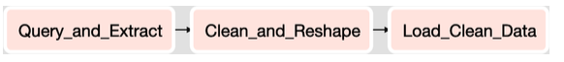
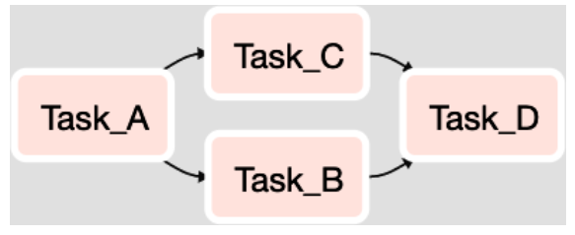
Workflow orchestration
Many 10-100s data pipelines
Schedule and manage flow of tasks according to their dependencies
E.g., Apache Airflow, Luigi, AWS Glue, Kubeflow
Pipeline and jobs are represented through DAGs

Slide 46
ETL paradigm
Extract
Gather data from various sources
Load
Move data into the final destination (e.g., data warehouse or data lake)
Transform
Raw data is combined and formatted to become useful for analysis step
Typically data ingestion = E + L

Slide 47
ELT paradigm
ETL has been the standard approach for long time
Today ELT is becoming the pattern of choice
Extract, Load, Transform
Enabled by cloud computing
Large storage to save all the raw data
Distributed data storage and querying (e.g., HDFS)
Columnar DBs
Data compression
Allow to separate data engineers and data scientists / analysts
Data engineers focus on data ingestion (E + L)
Data scientists focus on transform (e.g., SQL, MongoDB)
No need to know how the data will be used
ETL requires to understand the data at ingestion time

Slide 48
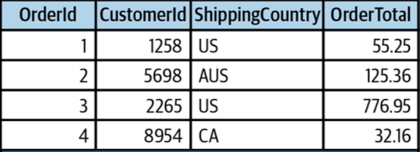
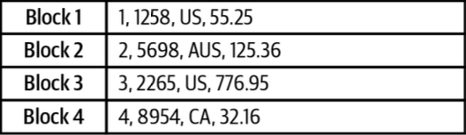
Row-based vs Columnar DBs
Row-based DBs
E.g., MySQL, Postgres
Optimized for reading / writing records
Read / write small amounts of data frequently
Columnar DBs
E.g., Amazon Redshift, Snowflake
Read / write large amounts of data infrequently
E.g., analytics requires a few columns

Slide 49
Data products
Data products:
a recommendation engine
personalized search engine
sentiment analysis on user-generated reviews
Powered by machine learning
Data ingestion
Data pre-processing
Cleaning, tokenization, feature computations
Model training
Model deployment
Monitor model
Is it working?
Is it getting slower?
Are performance getting worse?
Feedback from deployment
E.g., recommendations vs what users bought
Ingest data back for future versions of the model

Slide 50
EtLT
In ELT, transformations (“T”) according to business logic and data modelling are done after extraction (“E”)
Sometimes some transformations with limited scope (“t”) are needed
De-duplicate records
Parse URLs into individual components
Obfuscate sensitive data (for legal or security reasons)

Slide 51
UMD DATA605 - Big Data Systems DevOps with Docker

Slide 52
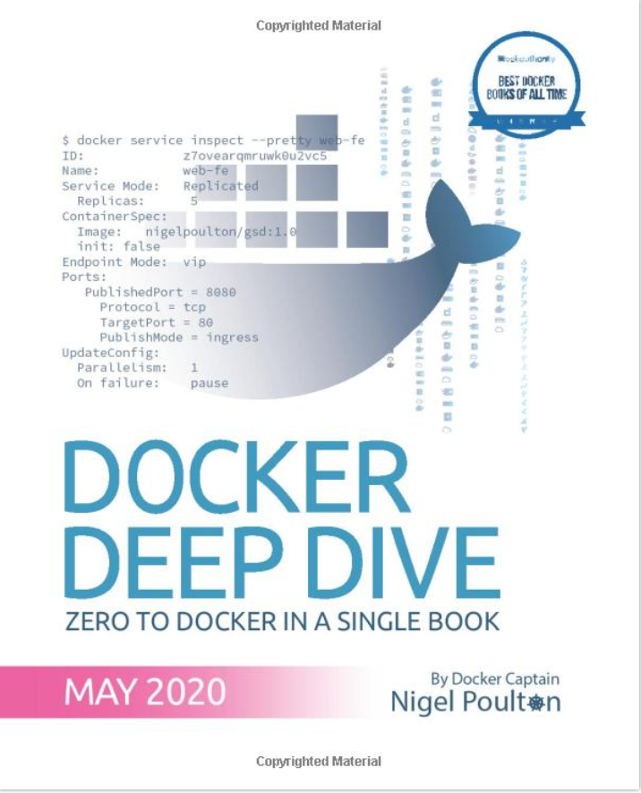
Docker - Resources
A Beginner-Friendly Introduction to Containers, VMs and Docker
Official Docker Getting Started Tutorial
Mastery:
Poulton, Docker Deep Dive: Zero to Docker in a single book, 2020
Google SRE book TODO
In this course, we will use Docker containers in order to easily set-up the environments to work with big data systems

Slide 53
DevOps
DevOps = practices that combines software development (devs) and IT operations (ops)
Problem: for many Internet companies, the application is the business
E.g., Amazon, Expedia, Google, Facebook
If the application breaks, the business stops working
Solutions:
Before virtualization (before 2000s)
Virtual machine era (2000s-2010s)
Container era (> ~2013)
Container technology revolutionized DevOps
Enable true independence between applications and IT ops
Create a model for better collaboration (fewer conflicts) and innovation
“It doesn’t work!”
“What? It works for me”

Slide 54
Before Virtualization
< 2000s
“Run on the metal”
Running multiple applications on the same server was not safe and secure
IT would buy a new server for each application
Difficult to spec the machine
Buy “big and fast servers”
Overpowered servers operating at 5-10% of capacity
Tons of money in the DotCom boom was spent on machines and networks

Slide 55
Virtual Machine Era
Circa 2000
Pros
VM ran safely and securely multiple applications on a single server
IT could run apps on existing servers with spare capacity
Cons
Every VM requires an OS (waste of CPU, RAM, and disk)
Monitor and patch each OS
Buy an OS license
VMs are slow to boot

Slide 56
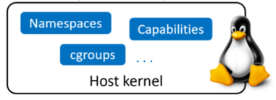
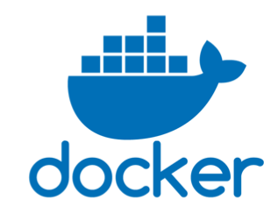
Containers Era
Circa 2013
Pros
Containers don’t require full-blown OS
All containers run on a single host
Reduce OS licencing cost
Reduce overhead of OS patching and maintenance
Containers are fast and portable
Linux supported containers for some time
Kernel namespaces
Control groups
Union filesystems
Docker
Didn’t invent containers
Made containers simple and mainstream

Slide 57
Serverless Computing
Containers run in a Virtual Machine which runs on a host, e.g.,
Your laptop
On premise
Cloud instance (e.g., EC2)
On a virtual machine
On a virtual machine running a virtual machine
Bare-metal server
As long your code runs somewhere, you don’t care “how” or “where” (serverless)

Slide 58
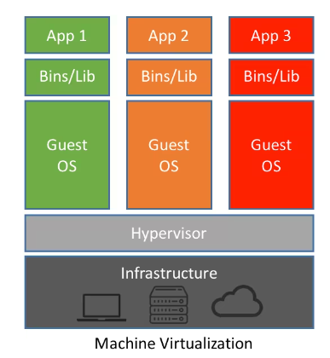
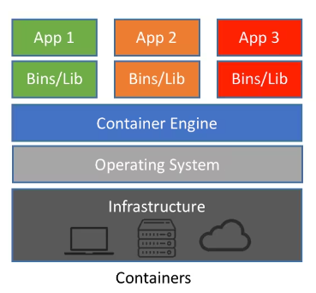
OS vs Container Virtualization
VMs
Hypervisor boots
Hypervisor performs HW virtualization
Carves out physical hardware resources into VMs
Resources (CPU, RAM, storage) are allocated to a VM
“VM tax”: to run 4 apps, need 4 VMs and 4 OSes
Each VM requires time to start
Consume CPU, RAM, storage
Need a license
Need admins
Containers
Docker performs OS virtualization

Slide 59
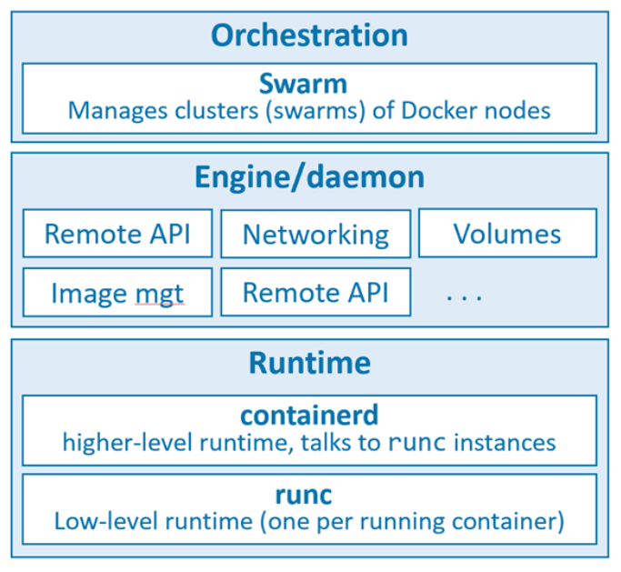
Docker Architecture
Docker run-time
runc: start and stop containers
containerd:
Pull images
Create volumes, network interfaces
Docker engine
dockerd:
Expose remote API
Manage images, volumes, networks
Docker swarm
Manage clusters of node
Replaced by Kubernetes
Open Container Initiative (OCI)
Standardize low-level components of container infrastructure
E.g., image format, run-time API
“Death” of Docker

Slide 60
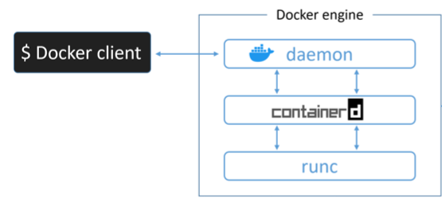
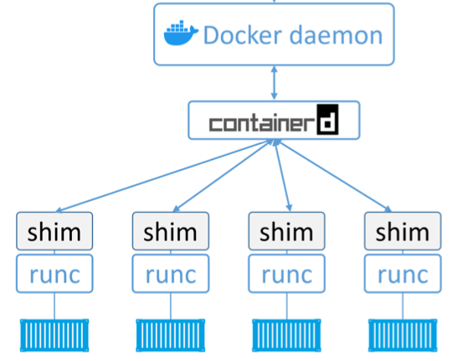
Docker: Server-Client
Server-client architecture
Docker client
Command line interface
Communicate through IPC socket /var/run/docker.sock or IP ports
Docker engine
Run and manage containers
Modular and built from several OCI-compliant sub-systems
E.g., Docker daemon, containerd, runc, plug-ins for networking and storage

Slide 61
Ops vs Devs
Devs
Implement the app (e.g., Python, virtual env)
Containerize the app
Create Dockerfile
Contain the instruction on how to build an image
Build image
Run app as a container
Test locally
Ops
Download image
Contain filesystem, application, app dependencies
It’s like a “class” in Python (or a stopped VM)
Start container
It’s like an object = instance of an object
Run command
Destroy container
In case of issues, it’s easy to repro the problem
Here is the log
Run this command line
Deploy on a test system and debug

Slide 62
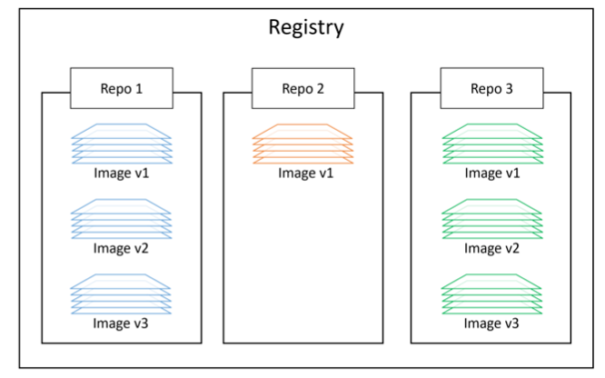
Docker Containers
Docker Containers
Lightweight, stand-alone, executable software package
Includes everything needed to run
E.g., code, runtime, system tools, system libraries, settings
Run-time objects
vs Docker images are built-time objects
Docker repos
Store Docker images
<registry>/<repo>:<tag> alpine:latest
E.g., DockerHub, AWS ECS
Some repos are vetted by Docker
Unofficial repos shouldn’t be trusted

Slide 63
Docker Image
Docker images
Unit of deployment
Contain everything needed by an application to run
Application code
Application dependencies
Minimal OS support
Can build images from Dockerfiles
Can pull pre-built from image registry
Multiple layers stacked on top of each other
Typically few 100s MBs

Slide 64
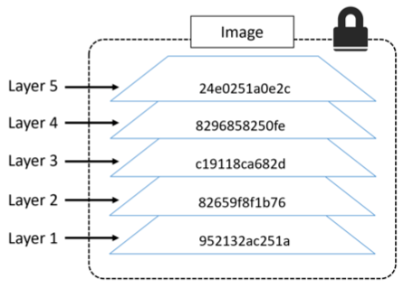
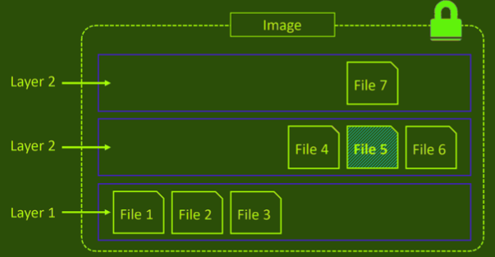

Docker Image Layers
A docker image is a configuration file that lists the layers and some metadata
It is composed of read-only layers
Each layer comprising one or more files
Each layer is independent from each other
Docker driver:
Stacks these layers representing them as a unified filesystem
Files from the top layers can obscure the files from the bottom layer
Implements a copy-on-write behavior
Each layer has hash
Hash is based on their content
Images are pulled and pushed compressed the hash of a compressed layer is different
A "distribution hash" is used
Each image has a hash:
The hash is function of the config file and of the layers
When an image changes, a new hash is generated

Slide 65
Docker: Container Data
Data inside of containers is persisted as long as the container is not killed
If you stop or pause a container data is not lost
Containers are designed to be immutable
It's not good practice to write “persistent” data into containers
Bind-mounting a local dir
A local dir is mounted to a dir inside a container
Docker provides volumes that exist separately from the container
E.g., to store the content of a Postgres DB

Slide 66
Containerizing an app
Develop your application code using the needed dependencies
Directly inside a container
Inside a virtual env
Create a Dockerfile describing
your app
its dependencies
how to run it
Build image with `docker image build`
(Optional) Push image to a registry
Run container from image

Slide 67
Building a container
Dockerfile
Describe how to create a container
Build context
> docker build -t web:latest .
Directory containing the application and its dependencies
Typically the Dockerfile is in the root directory of the build context

Slide 68
Docker volumes

Slide 69
Docker networks

Slide 70
Docker commands
Usage: docker [OPTIONS] COMMAND
A self-sufficient runtime for containers
Options:
--config string Location of client config files (default "/Users/saggese/.docker")
-c, --context string Name of the context to use to connect to the daemon (overrides DOCKER_HOST env var and default context set
with "docker context use")
-D, --debug Enable debug mode
-H, --host list Daemon socket(s) to connect to
-l, --log-level string Set the logging level ("debug"|"info"|"warn"|"error"|"fatal") (default "info")
--tls Use TLS; implied by --tlsverify
--tlscacert string Trust certs signed only by this CA (default "/Users/saggese/.docker/ca.pem")
--tlscert string Path to TLS certificate file (default "/Users/saggese/.docker/cert.pem")
--tlskey string Path to TLS key file (default "/Users/saggese/.docker/key.pem")
--tlsverify Use TLS and verify the remote
-v, --version Print version information and quit
Management Commands:
builder Manage builds
buildx* Docker Buildx (Docker Inc., v0.8.2)
compose* Docker Compose (Docker Inc., v2.6.1)
config Manage Docker configs
container Manage containers
context Manage contexts
extension* Manages Docker extensions (Docker Inc., v0.2.7)
image Manage images
manifest Manage Docker image manifests and manifest lists
network Manage networks
node Manage Swarm nodes
plugin Manage plugins
sbom* View the packaged-based Software Bill Of Materials (SBOM) for an image (Anchore Inc., 0.6.0)
scan* Docker Scan (Docker Inc., v0.17.0)
secret Manage Docker secrets
service Manage services
stack Manage Docker stacks
swarm Manage Swarm
system Manage Docker
trust Manage trust on Docker images
volume Manage volumes
Commands:
attach Attach local standard input, output, and error streams to a running container
build Build an image from a Dockerfile
commit Create a new image from a container's changes
cp Copy files/folders between a container and the local filesystem
create Create a new container
diff Inspect changes to files or directories on a container's filesystem
events Get real time events from the server
exec Run a command in a running container
export Export a container's filesystem as a tar archive
history Show the history of an image
images List images
import Import the contents from a tarball to create a filesystem image
info Display system-wide information
inspect Return low-level information on Docker objects
kill Kill one or more running containers
load Load an image from a tar archive or STDIN
login Log in to a Docker registry
logout Log out from a Docker registry
logs Fetch the logs of a container
pause Pause all processes within one or more containers
port List port mappings or a specific mapping for the container
ps List containers
pull Pull an image or a repository from a registry
push Push an image or a repository to a registry
rename Rename a container
restart Restart one or more containers
rm Remove one or more containers
rmi Remove one or more images
run Run a command in a new container
save Save one or more images to a tar archive (streamed to STDOUT by default)
search Search the Docker Hub for images
start Start one or more stopped containers
stats Display a live stream of container(s) resource usage statistics
stop Stop one or more running containers
tag Create a tag TARGET_IMAGE that refers to SOURCE_IMAGE
top Display the running processes of a container
unpause Unpause all processes within one or more containers
update Update configuration of one or more containers
version Show the Docker version information
wait Block until one or more containers stop, then print their exit codes
Run 'docker COMMAND --help' for more information on a command.
[1mTo get more help with docker, check out our guides at https://docs.docker.com/go/guides/[0m
version: "3.8"
services:
web-fe:
build: .
command: python app.py
ports:
- target: 5000
published: 5000
networks:
- counter-net
volumes:
- type: volume
source: counter-vol
target: /code
redis:
image: "redis:alpine"
networks:
counter-net:
networks:
counter-net:
volumes:
counter-vol:

Slide 71
Docker Tutorial
cd projects
vi tutorial_docker.md

Slide 72
Docker Compose
Docker Compose deploys and manages multi-container applications running on a single node
Describe the app in a single declarative configuration file
Instead of scripts with long Docker commands
Compose talks to Docker API to achieve what you requested
E.g., you need a client app and Postgres DB
E.g., microservices
Web front-end
Ordering
Back-end DB
In 2020 Docker Compose has become an open standard for “code-to-cloud” process
To run on multiple hosts
Docker Stacks / Swarm
Kubernetes

Slide 73
Docker Compose File
The default name for a Compose file is `docker-compose.yml`
You can specify `-f` for custom filenames
YAML file
Top-level keys are:
`version`:
Mandatory first line to specify API version
Ideally always use the latest version
Typically 3 or higher
`services`:
Define the different microservices
`networks`:
Creates new networks
By default it creates a `bridge` network to connect multiple containers on the same Docker host
`volumes`:
Creates new volumes
Key in services describe a different “service” in terms of container
Inner keys specify the params of Docker run command
version: "3.8"
services:
web-fe:
build: .
command: python app.py
ports:
- target: 5000
published: 5000
networks:
- counter-net
volumes:
- type: volume
source: counter-vol
target: /code
redis:
image: "redis:alpine"
networks:
counter-net:
networks:
counter-net:
volumes:
counter-vol:

Slide 74
Docker Compose: Commands
> docker compose --help
Usage: docker compose [OPTIONS] COMMAND
Docker Compose
Options:
--env-file string Specify an alternate environment file.
-f, --file stringArray Compose configuration files
-p, --project-name string Project name
Commands:
build Build or rebuild services
convert Converts the compose file to platform's canonical format
cp Copy files/folders between a service container and the local filesystem
create Creates containers for a service.
down Stop and remove containers, networks
events Receive real time events from containers.
exec Execute a command in a running container.
images List images used by the created containers
kill Force stop service containers.
logs View output from containers
ls List running compose projects
pause Pause services
port Print the public port for a port binding.
ps List containers
pull Pull service images
push Push service images
restart Restart containers
rm Removes stopped service containers
run Run a one-off command on a service.
start Start services
stop Stop services
top Display the running processes
unpause Unpause services
up Create and start containers
version Show the Docker Compose version information

Slide 75
Docker Compose: Tutorial
From https://github.com/nigelpoulton/counter-app
cd projects/tutorial_docker_compose/
vi tutorial_docker_compose.md

Slide 76
UMD DATA605 - Big Data Systems Orchestration with Airflow

Slide 77

Orchestration - Resources
Tutorial
Mastery: Data Pipelines with Apache Airflow
Concepts in the slides
Mastery:
Web resources
Documentation
Tutorial

Slide 78


Workflow Managers
Data pipelines require to coordinate jobs across systems
Tasks run on a certain schedule
Tasks need to be executed in a specific order
Notify if a job fails
E.g., in a “live weather dashboard”
Fetch the weather data from API
Clean / transform the data
Push data to the dashboard / website

Slide 79

Workflow Managers
Workflow managers address the orchestration problem
E.g., Airflow, Luigi, Metaflow, make, cron ...
How to describe data pipelines
Static files (e.g., XML, YAML)
Workflows-as-code
Language supported
Provide scheduling
How to describe what and when to run
Provide backfilling
Horizontally scalable
Multiple runners
Provide monitoring web interfaces
Describe data pipelines as graphs
Nodes are tasks
(Direct) Edges are dependencies
DAGs
A task is executed only when all the ancestors have been executed
Independent tasks can be executed in parallel
Run failed tasks incrementally

Slide 80
(Apache) Airflow
Developed at AirBnB in 2015
Open-sourced as part of Apache
Batch oriented framework for building data pipelines
Pipelines described as code in Python
Pipelines represented as DAGs
Web-interface
Scheduler and rich scheduling semantics
Large ecosystem
Support many DBs
Many actions (e.g., emails)
Hosted and managed solution (e.g., AWS)
You will run Airflow on your laptop

Slide 81
Airflow
Retry
If a task fails it can be re-run (after a wait time) to recover from intermittent failures
Scheduling semantic
Describe when is the next scheduling interval
Similar to `cron`
Incremental processing
Time is divided in intervals given the schedule
A DAG can be executed only for data in that interval, instead of processing the entire data set
Backfilling
Execute a DAG for historical schedule intervals that occurred in the past
E.g., if the data pipeline has changed one needs to reprocess from scratch

Slide 82
Airflow: what doesn’t do well
Not great for streaming pipelines
Better for recurring or batch-oriented tasks
Prefers static pipelines
DAGs should not change (too much) between runs
No data lineage / versioning natively
You can build on top of that

Slide 83

Airflow: Components
Scheduler
Parses DAGs
Keep track of dependencies completed
Add tasks to the execution queue
Schedule tasks when time comes
Webserver:
Visualize DAGs
Monitor DAG runs and results
Metastore
Keep the state of the system (e.g., what nodes have been executed)
Queue
Tasks are
Queued up for execution when ready
Picked up by a pool of Airflow workers that execute the tasks and register their outcome

Slide 85
Airflow: CLI

Slide 86

Airflow: Example
From the tutorial for Airflow 2.2.2 here
The Python script is just a file describing the DAG’s structure in terms of code
There is no computation inside the DAG code
The Scheduler execute the code to pick up changes to the code
DAG object is used to instantiate an Airflow DAG
BashOperator creates a Task wrapping a Bash command

Slide 87


Airflow: Example
Dict with various default params to pass to the DAG constructor
Can have different set-ups for dev vs prod
Instantiate the DAG

Slide 88


Airflow: Example
Define tasks by instantiating operator objects
The default params are passed to all the tasks
Can be overridden explicitly
One can use a Jinja template

Slide 89

Airflow: Example
Add tasks to the DAG

Slide 90


Airflow: Example
Add tasks to the DAG

Slide 91
Airflow: Dockerfile

Slide 92
Airflow: Dockerfile

Slide 93
Airflow: Dockerfile

Slide 94
Airflow: Compose file

Slide 95
Airflow: compose file
How it looks like

Slide 96

Airflow tutorial

Slide 97


Slide 98
Airflow: Tutorial

Slide 99
Unit-testing
Continuous integration
Continuous deployment
GitHub actions, AWS Code, GitLab workflows, Jenkins

Slide 100
RESTful API
https://restfulapi.net/
REpresentational State Transfer
Style to develop distributed systems
REST API = Web service API conforming to the REST style
Uniform interface
Decide API interface for resources (e.g., document, services, URI, persons) exposed from your system and be consistent
Naming convention, link format, XML or JSON
Once a developer becomes familiar with one of your API, they should be able to follow a similar approach for other APIs
Client–server
Servers and clients need to be independent and talk only through the interface
I.e., servers / clients can be modified and should keep working as long as the interface is not changed
Stateless
Each request from client to server must contain all of the information necessary
It cannot take advantage of any stored state on the server
Inspired by HTTP (modulo cookies)
Cacheable
The data in a response should be labeled as cacheable or non-cacheable
If cacheable, the client can reuse the response later
Increase scalability and performance
Layered system
Each layer cannot "see" beyond the immediate layer that they interface
E.g., in a tier application
Code on demand (optional)
Client can be extended by downloading code

Slide 101
12-factor App
From https://12factor.net/

Slide 102
Stages of deployment

Slide 103
Semantic versioning

Slide 104
Idempotency

Slide 105
Microservices vs Monolith

